Slide 1
Case for 5G-Aware Video
Streaming Applications
Eman Ramadan, Arvind Narayanan, Udhaya Kumar Dayalan,
Rostand A. K. Fezeu, Feng Qian, Zhi-Li Zhang
Notes:
The main idea behind this work is to identify both the opportunities and challenges offered by emerging 5G services, and call for new mechanisms to make applications 5G-aware.

Slide 2


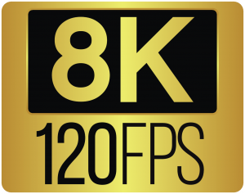
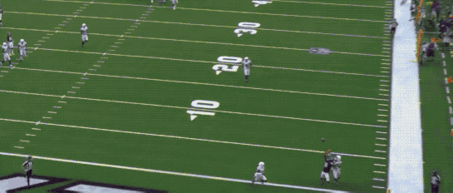
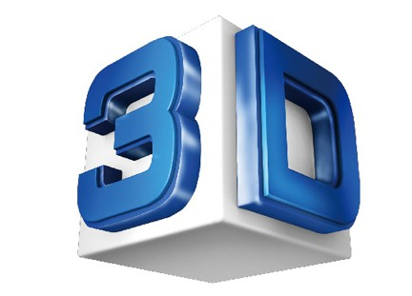
5G and mmWave 5G
low-band
high-band (mmWave)
mid-band
Key to support apps requiring ultra-high bandwidth
Source: Intel True View
Volumetric Video Streaming
AR/VR Services
Notes:
5G can be deployed using either low-band, mid-band, or high-band frequencies (millimeter wave), which differ in their coverage and bandwidth capacity.
For example, low-band provides the widest coverage, but can’t achieve ultra-high bandwidth as mmWave, which is the key to support bandwidth-intensive applications such as AR/VR services, ultra-HD (UHD) and volumetric video streaming on mobile devices .

Slide 3

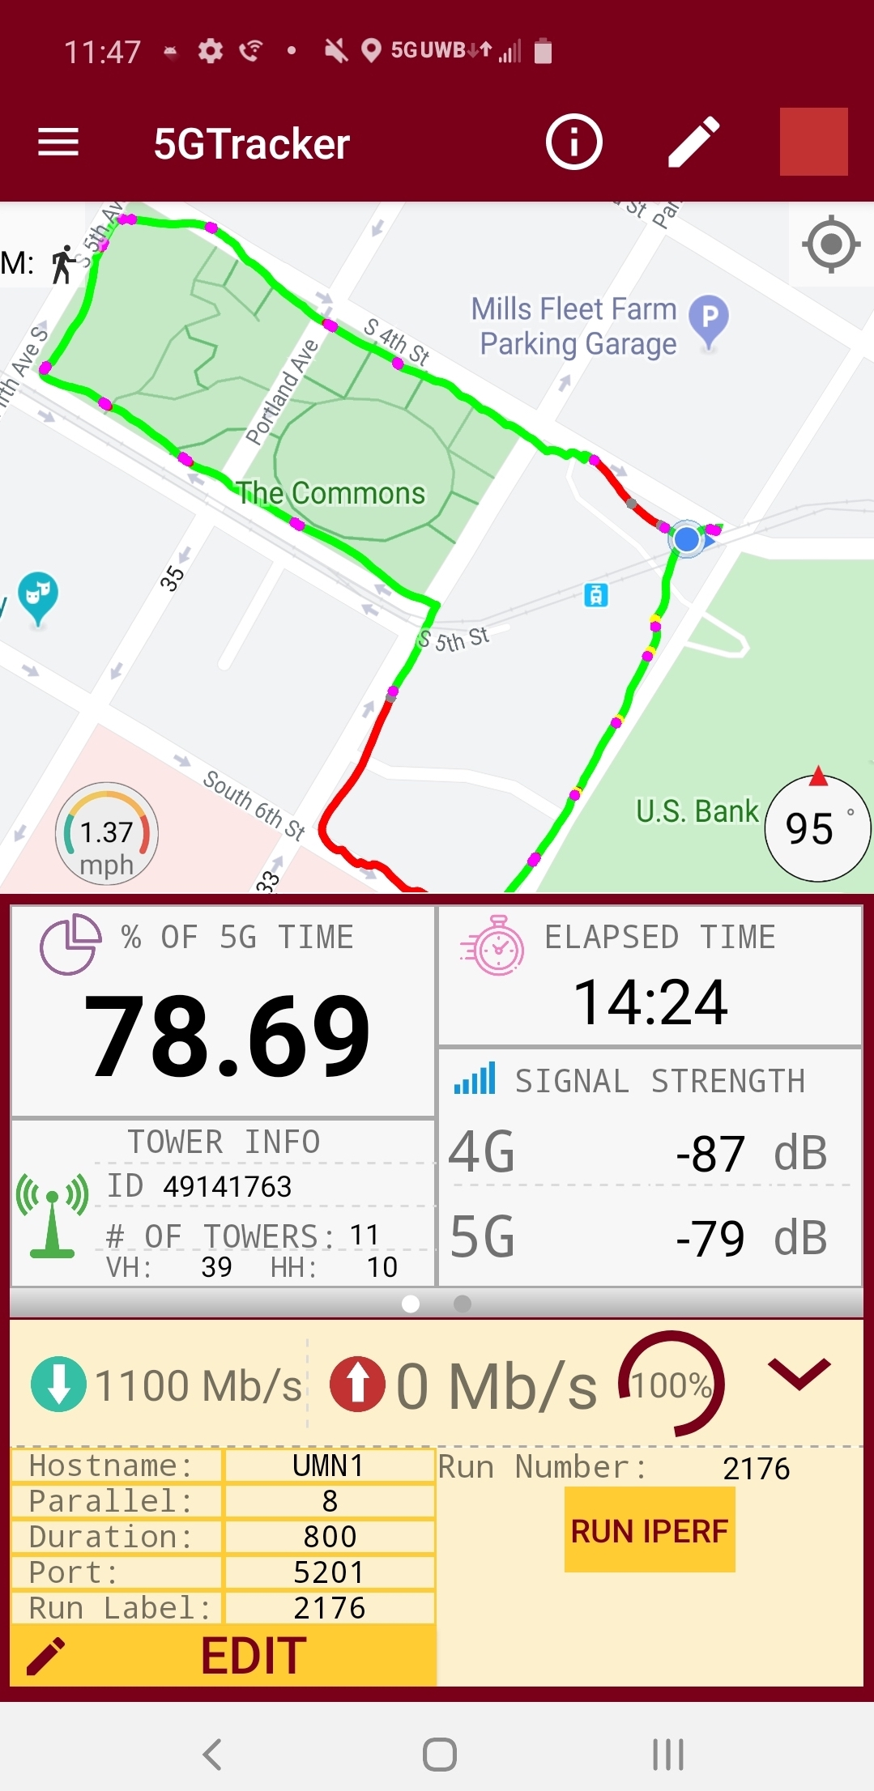



5G Throughput Characteristics
5G Tracker [1]
Samsung Galaxy S10 5G
Key Observations
Great performance (1.8 Gbps and beyond!)
Wild and frequent fluctuations in throughput, 5G Dead Zones
Due to mmWave directional nature, signal blockage, and sensitivity
to other environmental factors especially when the user is moving
5G = mmWave 5G*
*For simplicity, all references to 5G in the rest of the talk refers to mmWave 5G, unless explicitly mentioned otherwise.
[1] Arvind Narayanan, Eman Ramadan, et. al. 5G Tracker – A Crowdsourced Platform to Enable Research Using Commercial 5G Services. In ACM Special Interest Group on Data Communication (SIGCOMM ’20 Demos and Posters)
Notes:
Using our 5G Tracker android app deployed on a Samsung Galaxy S10 device equipped with Verizon’s mmWave 5G service, we measure the 5G throughput every second through a TCP bulk download session.
Our measurement tool collects also: timestamp} geolocation, tower ID, mobility mode {i.e., walking, still, driving\}, and the active radio type {5G or 4G}.
We hold two devices for measuring 4G and 5G and walk around a densely 5G deployed downtown area.
We can notice that 5G offers a throughput more than 1.8 Gbps which is much higher than 4G’s throughput enabling it to support bandwidth-hungry applications unlike 4G.
However, mmWave 5G throughput shows much higher variation, and can suddenly drop to 0~Gbps (referred to as 5G dead zones). In such spots, 4G/LTE might offer better performance than 5G.
This is due to mmWave's signal propagation issues.
This reveals new opportunities and challenges facing applications that are enabled by mmWave 5G.
For the rest of the talk, unless explicitly mentioned, all references to 5G refers to mmWave 5G.

Slide 4


Are (volumetric) video streaming applications ready to take advantage of 5G’s high throughput?
How does the wild throughput fluctuations affect the application performance?
Question 1
Question 2
Notes:
We use volumetric video streaming application as a case study, and answer these two basic questions:
Are (volumetric) video streaming applications ready to take advantage of 5G’s high throughput?
How does the wild throughput fluctuations affect the application performance?

Slide 5
Case Study: Volumetric Video Streaming
In volumetric ^{[1]} videos each frame consists of a 3D point cloud, enabling users to watch wearing a mixed reality (MR) headset and navigate with 6 DoF
A volumetric video can have 350K points per frame played at 30 FPS. Each point takes 9 bytes, yielding a total of: 350Kx30x9x8 = 756 Mbps when uncompressed
Source: Intel True View
Volumetric Video Streaming
[1] A sample of a high-quality volumetric video streaming can be found at https://www.youtube.com/watch?v=feGGKasvamg
Notes:
In volumetric ^{[1]} videos each frame consists of a 3D point cloud, enabling users to watch wearing a mixed reality (MR) headset and navigate with 6 DoF
A volumetric video can have 350K points per frame played at 30 FPS. Each point takes 9 bytes, yielding a total of: 350Kx30x9x8 = 756 Mbps
Which far exceeds the capacity of existing 4G service, but within the ultra-high bandwidth offered by 5G.
To understand the impact of the large, wild fluctuations of 5G throughput on existing video streaming applications,
we use a representative 5G trace to stream a 500 seconds video
We measure the performance by total stall time; when the player has to wait for a frame to be downloaded from the server

Slide 6
Volumetric Video Streaming Performance Under 5G Throughput
Stall time is significantly large (90 secs), experienced by 18% of video frames
Key Observations
Max number of frames in buffer 126 (4.2 sec)
Wild fluctuations in 5G throughput often lead to quick buffer depletion, especially when entering 5G “dead zones”
Notes:
We found the total Stall time is 90 secs, significantly large due to the sudden and quick drop in 5G throughput
This plot shows the buffer occupancy over time while streaming the video, we can notice that Max number of frames in buffer 126 (4.2 sec) which is not enough to cover longer dead zones which can extend to 20 secs
This trace-driven simulation shows that existing video streaming applications do not work well over mmWave 5G. Hence, we need to rethink about the way these applications are built to become 5G-aware.

Slide 7



Building 5G-Aware Video Streaming Apps
A) Need for New Throughput Prediction Mechanisms
B) Adaptive Streaming Mechanisms
Notes:
Video streaming applications rely on throughput estimation to specify the requested bitrate, so we first study whether the traditional methods still work or not for 5G?

Slide 8
A) Need for New Throughput Prediction Mechanisms
Traditional bandwidth estimation approaches which relies on short-term history
and use methods like harmonic mean are not adequate for 5G throughput prediction.
3G/4G networks can rely on location to predict the cellular performance, however mmWave 5G throughput is more complicated as it is affected by multiple factors^{[1]} and very sensitive to surrounding environment.
Despite the wild variability of 5G throughput, we found that by controlling the key factors affecting 5G, the throughput
largely becomes predictable ^{[1]}.
[1] Arvind Narayanan, Eman Ramadan, et. al. Lumos5G: Mapping and Predicting Commercial mmWave 5G (IMC’20).
Notes:
Traditional bandwidth estimation approaches which relies on short-term history are not adequate for 5G throughput prediction due to their wild variation and fluctuation which makes it tricky to map
Moreover, 3G/4G networks can rely on location to predict the cellular performance, however mmWave 5G throughput is more complicated as it is affected by multiple factors
This plot shows the distribution of variation seen in multiple 5G throughput traces collected along a walking route: the dark center curve represents the average throughput and shaded areas represent the 25% to 75% percentile range. We can notice that there are some patches when the throughput is consistently high, other batches the throughput is consistently low.
Despite the wild variability of 5G throughput, we found that by controlling the key factors affecting 5G, the throughput largely becomes predictable

Slide 9
User Side Factors
Geolocation
UE Moving Speed
UE Compass direction
[1] Arvind Narayanan, Eman Ramadan, et. al. Lumos5G: Mapping and Predicting Commercial mmWave 5G (IMC’20).
Notes:
Through field experiments, we empirically reveal several user-side factors impacting 5G throughput – which are far more sophisticated than those impacting 4G or LTE performance.
These factors include geolocation, moving speed, compass direction, which are collected by our 5GTracked app along with the throughput measurement.
The user’s distance from the panel and moving angles computed with respect to the 5G panel.
Instead of independently affecting 5G throughput, these factors may cause complex interplay that is difficult to reason and model analytically.
We therefore seek a data-driven learning-based approach for mmWave 5G throughput prediction.

Slide 10




User Side Factors
Geolocation
UE Moving Speed
UE Compass direction
N
🧭
UE-Panel Distance
UE-Panel Mobility Angle
Panel Direction
θ_{d}
θ_{m}
UE-Panel Positional Angle
θ_{p}
User Moving Direction
distance
5G Panel
moving speed
Geo-Coordinates
[1] Arvind Narayanan, Eman Ramadan, et. al. Lumos5G: Mapping and Predicting Commercial mmWave 5G (IMC’20).
Notes:
Through field experiments, we empirically reveal several user-side factors impacting 5G throughput – which are far more sophisticated than those impacting 4G or LTE performance.
These factors include geolocation, moving speed, compass direction, which are collected by our 5GTracked app along with the throughput measurement.
The user’s distance from the panel and moving angles computed with respect to the 5G panel.
Instead of independently affecting 5G throughput, these factors may cause complex interplay that is difficult to reason and model analytically.
We therefore seek a data-driven learning-based approach for mmWave 5G throughput prediction.

Slide 11
User Side Factors
Geolocation
UE Moving Speed
UE Compass direction
N
🧭
UE-Panel Distance
UE-Panel Mobility Angle
Panel Direction
θ_{d}
θ_{m}
UE-Panel Positional Angle
θ_{p}
User Moving Direction
distance
5G Panel
moving speed
Geo-Coordinates
Numerous UE-side factors impact 5G throughput.
Complex interplay of factors that diversify across regions, thus non-trivial to model analytically.
We therefore seek a “data-driven learning-based approach” for 5G throughput prediction.
[1] Arvind Narayanan, Eman Ramadan, et. al. Lumos5G: Mapping and Predicting Commercial mmWave 5G (IMC’20).
Notes:
Through field experiments, we empirically reveal several user-side factors impacting 5G throughput – which are far more sophisticated than those impacting 4G or LTE performance.
These factors include geolocation, moving speed, compass direction, which are collected by our 5GTracked app along with the throughput measurement.
The user’s distance from the panel and moving angles computed with respect to the 5G panel.
Instead of independently affecting 5G throughput, these factors may cause complex interplay that is difficult to reason and model analytically.
We therefore seek a data-driven learning-based approach for mmWave 5G throughput prediction.

Slide 12








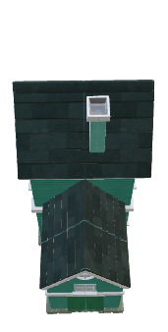


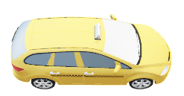






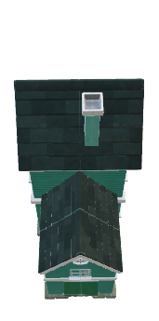


Lumos5G^{[1]} - a ML framework to predicting mmWave 5G Performance
1000+ Mbps
Lumos5G
Alice
Tower A
Bob
Tower B
Daisy
Tower C
Tower D
Charlie
< 60 Mbps
[1] Arvind Narayanan, Eman Ramadan, et. al. Lumos5G: Mapping and Predicting Commercial mmWave 5G (IMC’20).
Notes:
In our IMC paper we presented
\textit{Lumos5G} -- a composable machine learning framework which considers different combinations of contextual and environmental factors, and applies the state-of-the-art machine learning algorithms for making context-aware 5G throughput predictions
Considering users in an urban park deployed with mmWave 5G service.
Lumos5G accounts for such factors and predicts 5G throughput with higher accuracy than existing methods. For more info. please refer to our IMC paper.
With the ability to predict the near future 5G performance in/around the current user's location, video streaming applications can then make intelligent decisions to download video frames as we explain next.
Users around the park might experience frequent throughput fluctuations and handoffs using mmWave. But at the same time, they also have access to the ultra-high throughput offered by mmWave.
As observed earlier, besides geolocation, 5G’s performance relies on user-side contextual factors such as the direction of user mobility, etc.

Slide 13
Building 5G-Aware Video Streaming Apps
A) Need for New Throughput Prediction Mechanisms
B) Adaptive Streaming Mechanisms
Notes:
We now discuss several mechanisms to enable applications to fully take advantage of ultra-high bandwidth afforded by (mmWave) 5G while also mitigate the impact of high throughput variability due to fast varying frequency radio bands.

Slide 14




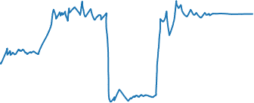
B) Adaptive Streaming Mechanisms
Adaptive Content Bursting:
  Burst sufficient amount of application data to the 5G radio network so that the 5G radio resource control sub-layer can fully take advantage of available radio resources whenever possible
  Utilizing the available ultra-high bandwidth to request future frames in addition to current frames to be in buffer during 5G dead zones
  Requires provisioning larger buffer at the radio network, ensuring there is always sufficient data in the per-user buffer & entails allocating larger buffer at the UE/client side
5G Throughput
Edge Server
5G-RAN
5G Dead
Zone
Buffer
time
UE
UE Buffer
Notes:
The first approach is adaptive content bursting to allow applications to fully take advantage of the available radio resources under good network conditions to download future frames as well as current frames to prepare for and bridge over the 5G bandwidth troughs and dead zones.
This requires employing (significantly) larger buffers (both at the client side as well as within the 5G radio network) .
Based on ml prediction, content bursting is enabled when a user reaches an area with ultra-high bandwidth to download additional frames to the buffer which can be used to cover the 5G dead zone till the user reaches a high throughput area

Slide 15
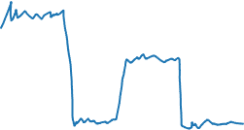
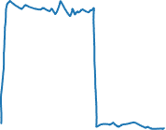
B) Adaptive Streaming Mechanisms
Dynamic radio (band) Switching:
  Switching between 5G high-band to low-band, or 5G to 4G
  E.g., based on the 4G throughput and the predicted 5G throughput from ML, we proactively decide to switch the network connection for “5G mode” to “4G mode” or vice versa
  Maintaining 4G basic connectivity to handle 5G dead zones
Selected Active Radio
4G Throughput
5G Throughput
Notes:
Through our extensive experiments, [click] we find that in some patches while UE is connected to 5G, 4G in fact yields a higher throughput.
Hence, dynamic switching} (e.g., between 5G and 4G or between 5G high, mid, and low bands) is crucial in maintaining session connectivity and ensuring minimal bitrates. click
We believe that combining these new (cross-layer) mechanisms, coupled with effective ML-based throughput prediction, will be the key to enable this new class of bandwidth-intensive applications and help them mitigate various PHY-layer challenges posed by mmWave 5G radio making them {\em 5G-aware}.

Slide 16
Evaluation
Using a representative 5G throughput trace captured while the user is walking at 1.4 m/s
500-seconds volumetric video requested at 350K points per frame
Emulate watching the video using 3 modes:
  5G only: using only the 5G throughput trace
  Dynamic 5G/4G Switching: proactively switch between 4G and 5G based on their throughput
  Content Bursting + Dynamic Switching: in addition to dynamic switching, the player proactively bursts future content when ultra-high bandwidth is available
Notes:
We demonstrate the benefits of these mechanism through trace-driven experiments Using a representative 5G throughput trace captured while the user is walking at 1.4 m/s
To request a 500-seconds volumetric video requested at 350K points per frame
Emulate watching the video using 3 modes

Slide 17
Buffer Occupancy and Stall Time
a) 5G Only
b) Dynamic 4G/5G Switching
c) Content Bursting +
Dynamic Switching
Key Observations
Using 5G Only is not enough, due to having a maximum throughput of 200 Mbps in 5G dead zones.
Dynamic 4G/5G Switching shields some dead zones but not all (due to 4G maintaining basic connectivity)
Content Bursting + Dynamic Switching significantly reduces stall time, but does not eliminate it
Notes:
5G 90 secs, , the user has to wait till they pass these dead zones and get back 5G connectivity to resume fetching frames
Dynamic switch 70 secs
Content bursting 21 secs, maximum buffer occupancy increased to 724 frames

Slide 18
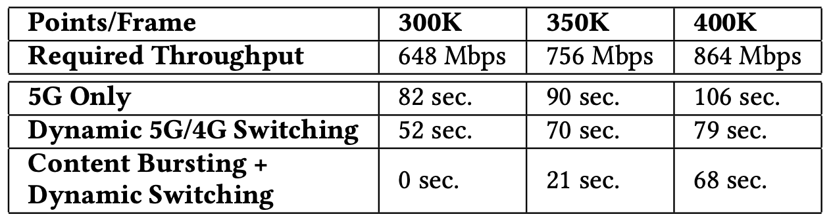
Selecting Appropriate Video Bitrate to Eliminate Stall Time
Key Observations
Selecting the appropriate bitrate eliminates the stall time
Notes:
This table summarizes the stall time for different modes and video qualities.
Also. when the video quality increases, the buffer takes more time to build and consequently gets depleted quickly before/at the dead zones increasing the stall time even when \textit{Content Bursting + Dynamic Switching} mode is employed.
Requesting frames using the video quality at 300K points eliminates any stalls overcoming the throughput fluctuation and dead zones in the 5G throughput trace, while other higher video qualities always result in a stall time.
Please refer to our paper for the theorem defined to calculate the quality to eliminate stall time when the 5G throughput prediction is known ahead of time.

Slide 19

Future Research Opportunities
Scalable Video Coding (SVC)
Streaming Variable Quality
Multiband Video Streaming
Notes:
Our study clearly constitutes only an initial step towards this direction -- much more work needs to be done by the research community to make applications {\em 5G-aware}.
In SVC, a frame is encoded in a base layer (lowest quality), and multiple enhancement layers which can be used to improve the quality in an incremental way.
For each frame, if the base layer is missing at the playback time, a stall will occur; if the higher-quality enhancement layers are missing but not the base layer, the frame will be played at a low quality to avoid stalls;
if all layers are present, the frame will be played at the original (highest) quality.
When the available bandwidth changes, instead of prefetching frames with a constant bitrate, a more judicious decision can be made to decide which quality to use based on the predicted future bandwidth, its variability, and the buffer occupancy.
The goal is to develop an adaptive algorithm which can avoid stalls while at the same time deliver the highest possible quality with smooth quality variation.
Since the debut of commercial 5G deployments, carriers supported a single class of frequency range. Due to the limited coverage of high-band mmWave, several carriers now consider deploying multiple frequency bands to achieve higher data rates. In such situations, low-band and mid-band 5G will allow carriers to provide stable 5G service with wider coverage, while offering mmWave 5G to support bandwidth-heavy applications. For video streaming apps, Low-band can be used to stream the base layer, while simultaneously mid-band/high-band 5G are used to stream higher quality enhancement layers.

